Slide 1
Linear Regression
Vera Hollink
2025

Slide 2

Summary last class

Slide 3
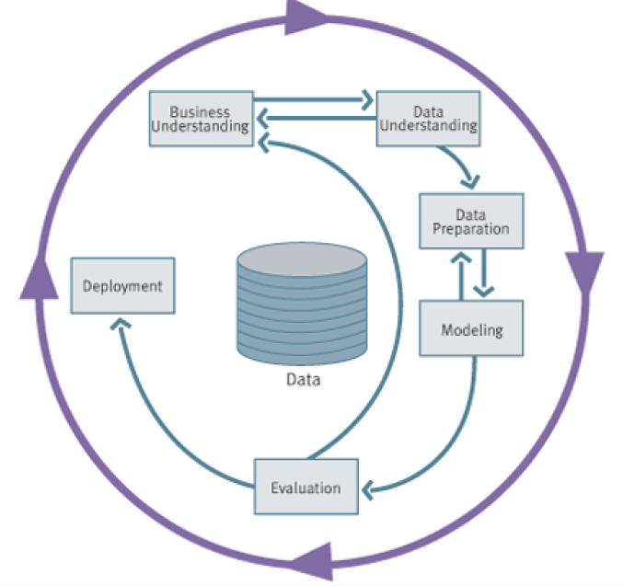
Data Mining Process: CRISP-DM
Image from “Data Science for Business”, Provost and Fawcett, 2013
Notes:
* Cross-Industry Standard Process for Data Mining (Shearer, 2000)

Slide 4
Handling missing values
Name | Color | Age | Weight
Fikki | Blue | 5
Minoes | UNKNOWN | 7 | 8
Doodles | Red | ? | 34
1. Do nothing
2. Remove the sample
3. Remove the attribute
4. Encode
5. Impute

Slide 5
Encoding non-numerical variables
Label encoding
ordinal variables
One-hot encoding
categorical variables
Name | Size category
Bobo | 0
Johnny | 1
Noeshka | 1
Pip | 2
Name | Species_guinea_pig | Species_cat | Species_dog
Bobo | 1 | 0 | 0
Johnny | 0 | 1 | 0
Noeshka | 0 | 1 | 0
Pip | 0 | 0 | 1

Slide 6
Scaling (normalization)
Min-max normalization
Z-score normalization

Slide 7
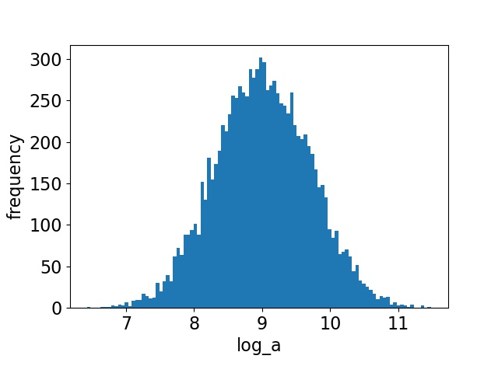
Feature engineering
new feature from existing features
surface = length * width
Polynomial transformation
a, b, ab, a², b²
Logarithmic transformation
log(x)
Binning
1-5, 5-10, 10-15

Slide 8
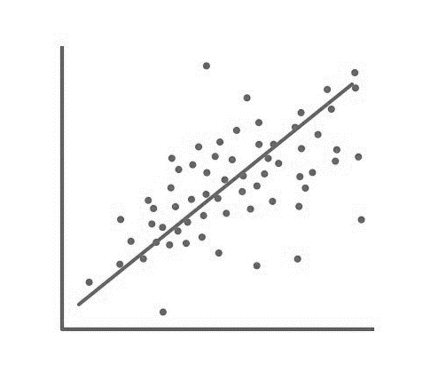
Linear regression

Slide 9
Overview
What is linear regression
Least square regression
Model evaluation
Prediction interval
Linear regression in Python

Slide 10
Overview
What is linear regression
Least squares regression
Model evaluation
Prediction interval
Linear regression in Python

Slide 11
Data Mining Process: CRISP-DM
Image from “Data Science for Business”, Provost and Fawcett, 2013
Notes:
* Cross-Industry Standard Process for Data Mining (Shearer, 2000)

Slide 12
What is regression/prediction?
Number of active clients
Server response time
How long will it take with 40 clients?
#Clients | Time (ms)
15 | 855
60 | 3214
32 | 1680
12 | 693
4 | 301

Slide 13
What is regression/prediction?
Model data as function
Use model for prediction
response_time = 100 + 50 * #Clients
With 40 clients:
response_time = 100 * 50 * 40 = 2100 ms

Slide 14
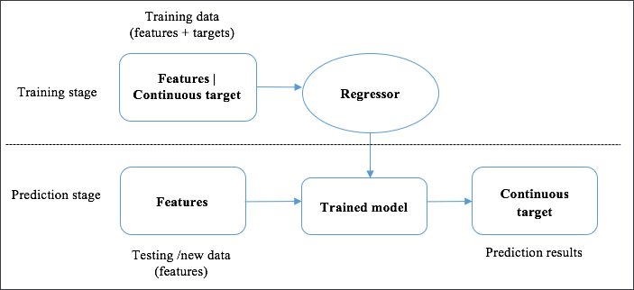
What is regression/prediction?
Predicting a numerical value
Supervised or unsupervised?
Supervised

Slide 15





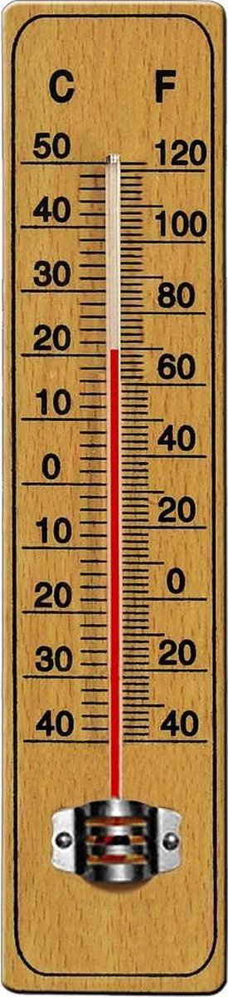
Examples
Sales
Hospital stay
Power supply and demand
Stock prices
Grades
Temperature
…

Slide 16
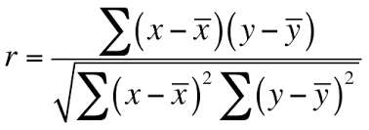
Recall: Pearson’s correlation coefficient
mean x
mean y
x | y
4 | 0.2
6 | 0.8
3 | 0.2
9 | 1.6
10 | 2.7

Slide 17
Regression equation
Regression Line or Estimated Regression Equation (ERE):
ŷ Estimated value of response variable
b₀ y-intercept of regression line
b₁ slope of regression line
Together, b₀ and b₁ are regression coefficients

Slide 18
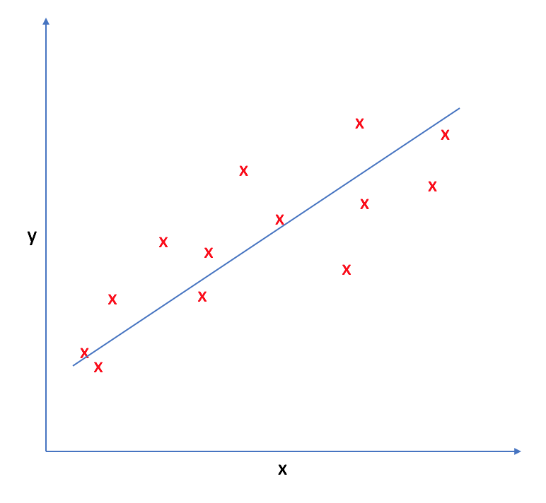
Which regression line is best?

Slide 19
Overview
What is linear regression
Least squares regression
Model evaluation
Prediction interval
Linear regression in Python

Slide 20
Residuals
Difference between predicted value and actual value: prediction error

Slide 21
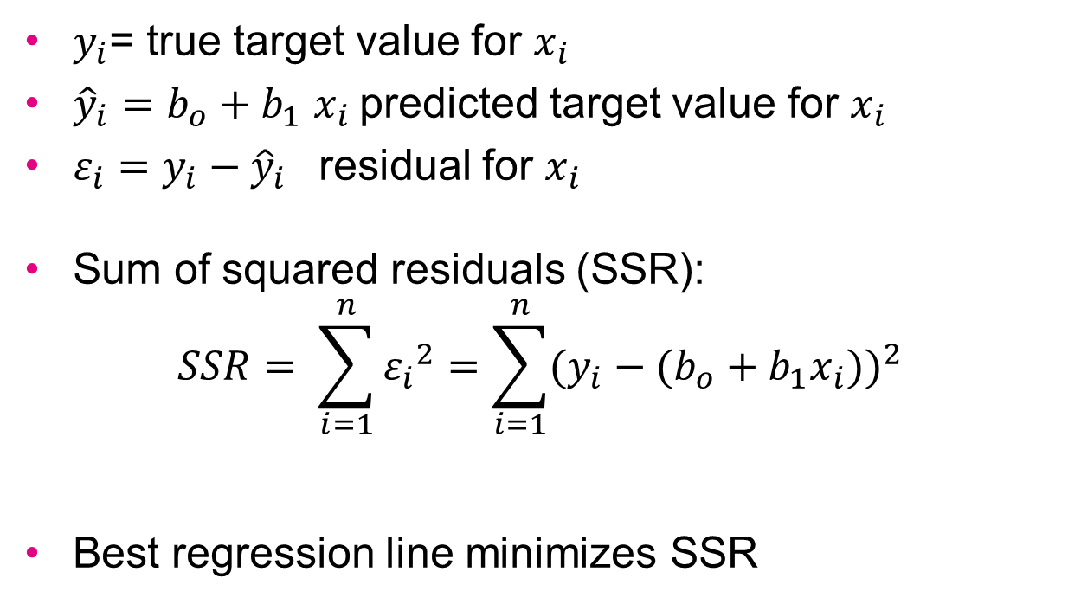
Least squares regression line
$y_{i}$= true target value for $x_{i}$
${\hat{y}}_{i}=b_{o}+b_{1}$ $x_{i}$predicted target value for $x_{i}$
${{ε_{i}=y}_{i}−\hat{y}}_{i}$ residual for $x_{i}$
Sum of squared residuals (SSR):
$$SSR= \sum_{i=1}^{n}{{ε_{i}}^{2}}=\sum_{i=1}^{n}{{({y_{i}−(b}_{o}+b_{1}x_{i}))}^{2}}$$
Best regression line minimizes SSR

Slide 22
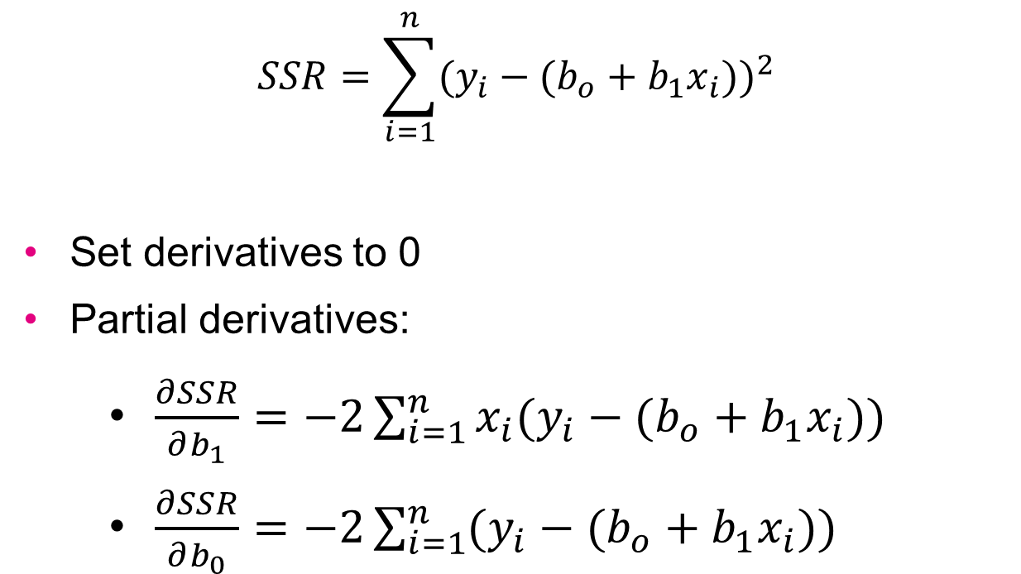
How to minimize a function?
$$SSR=\sum_{i=1}^{n}{{({y_{i}−(b}_{o}+b_{1}x_{i}))}^{2}}$$
Set derivatives to 0
Partial derivatives:
$\frac{∂SSR}{∂b_{1}}=−2\sum_{i=1}^{n}{x_{i}({y_{i}−(b}_{o}+b_{1}x_{i}))}$
$\frac{∂SSR}{∂b_{0}}=−2\sum_{i=1}^{n}{({y_{i}−(b}_{o}+b_{1}x_{i}))}$

Slide 23
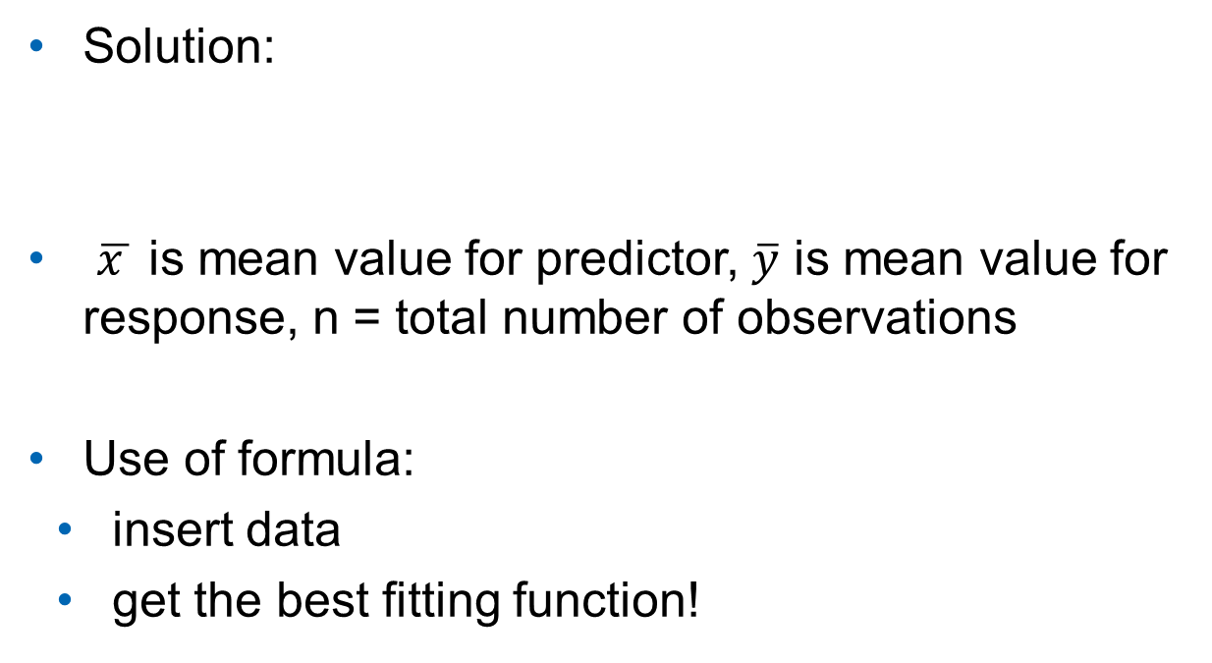
The Least Squares Estimates
Solution:
$\overline{x }$ is mean value for predictor, $\overline{y}$ is mean value for response, n = total number of observations
Use of formula:
insert data
get the best fitting function!

Slide 24
Overview
What is linear regression
Least squares regression
Model evaluation
Prediction interval
Linear regression in Python

Slide 25
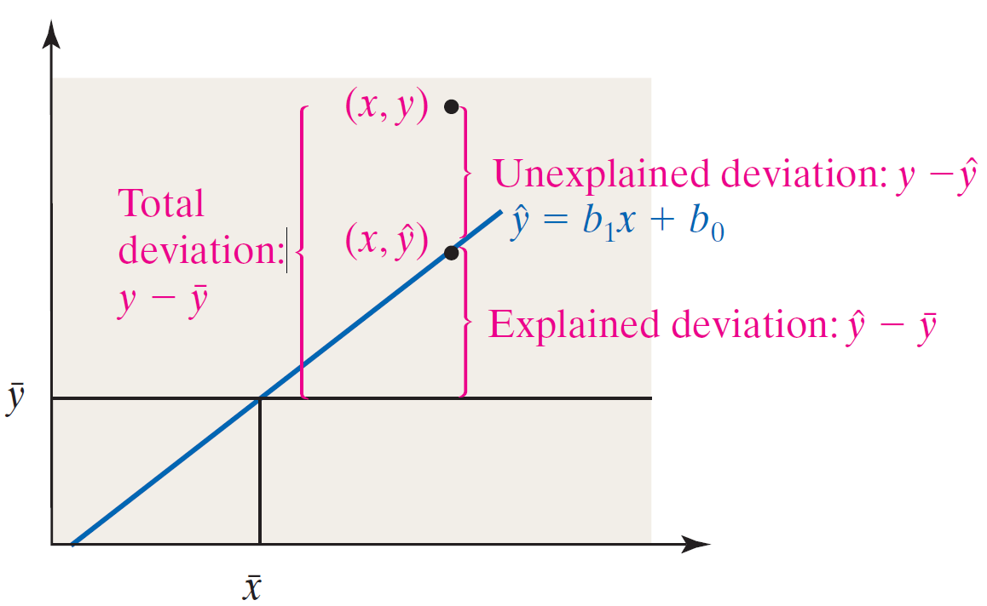
How good is the model?
Coefficient of Determination R²:
proportion of variance in y explained by ERE

Slide 26
How good is the model?
Coefficient of Determination R²:
Between 0 and 1
0: model explains nothing
No linear correlation
1: models explains all variance
Perfect linear correlation
Only for univariate regression
R² = r² (Pearson)

Slide 27

Regression Model Assumptions
Our data points are a sample from a population
We find ERE $\hat{y}=b_{1}x+b_{0}$
Different sample → different values for $b_{0}$ and $b_{1}$

Slide 28
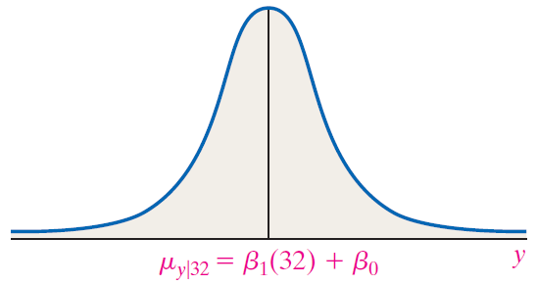
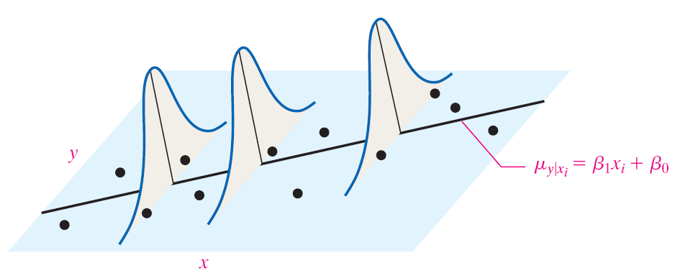

Regression Model Assumptions
different for every-x value
For any x-value, y-values are normally distributed
Mean: $μ_{y|x}=β_{1}x+β_{0}$
Standard deviation: $σ=s_{e}$
Standard error of the estimate:
the same for every-x value

Slide 29
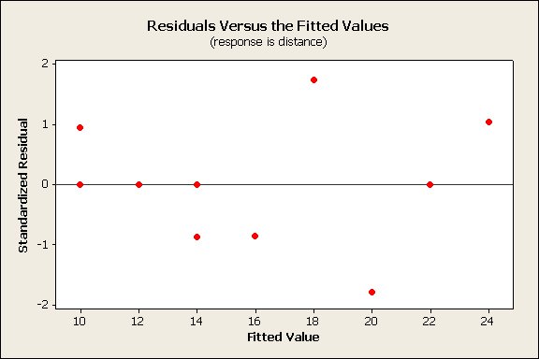
Verify model assumptions
Plot Standardized Residuals vs Predicted Values
Regression line (ERE) shown as horizontal line
Pattern in residuals → regression assumptions violated

Slide 30

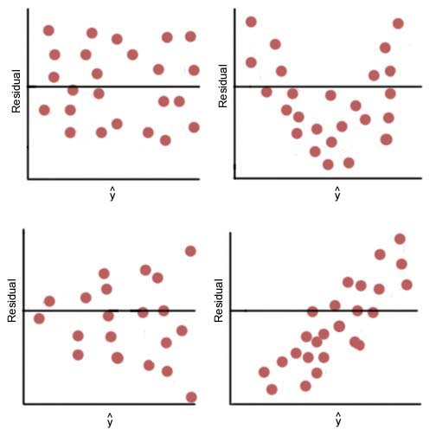
Residuals vs Predicted Values
A
B
C
D
Notes:
A No pattern => assumptions met
B independence assumption violated
C constant variance assumption violated
D zero mean assumption violated

Slide 31
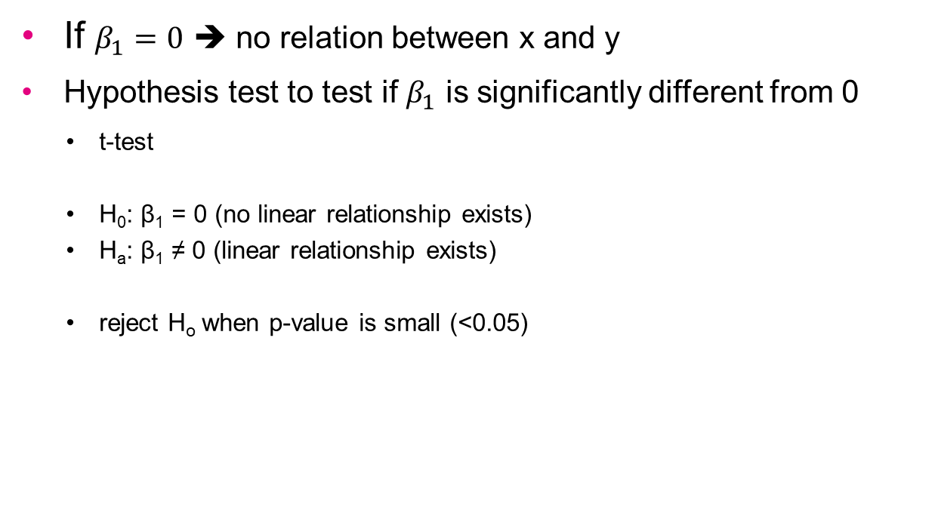
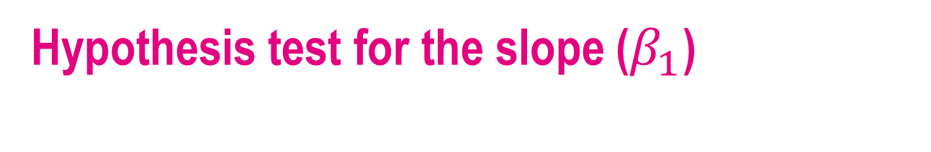
Hypothesis test for the slope ($β_{1}$)
If $β_{1}=0$ ➔ no relation between x and y
Hypothesis test to test if $β_{1}$ is significantly different from 0
t-test
H₀: β₁ = 0 (no linear relationship exists)
H_{a}: β₁ ≠ 0 (linear relationship exists)
reject H_{o} when p-value is small (<0.05)

Slide 32
Overview
What is linear regression
Least squares regression
Model evaluation
Prediction interval
Linear regression in Python

Slide 33
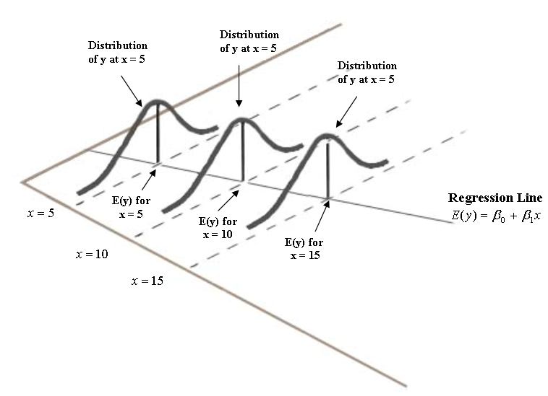

Prediction interval
For $x_{i}$ we predict ${\hat{y}}_{i}$
Prediction is uncertain
Prediction interval: for given $x_{i}$ 95% of true $y_{i}$-values are between … and …

Slide 34
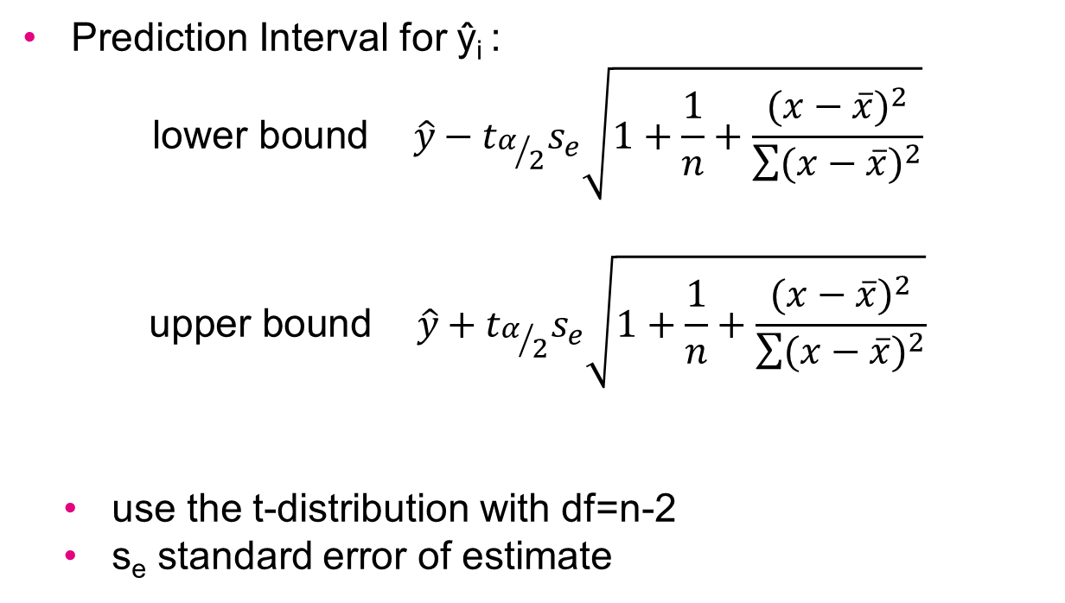
Prediction Interval
Prediction Interval for ŷ_{i} :
$$\text{lower} \text{bound} \hat{y}−t_{α/2}s_{e}\sqrt{1+\frac{1}{n}+\frac{{(x−\overline{x})}^{2}}{\sum{{(x−\overline{x})}^{2}}}}$$
$$\text{upper} \text{bound} \hat{y}+t_{α/2}s_{e}\sqrt{1+\frac{1}{n}+\frac{{(x−\overline{x})}^{2}}{\sum{{(x−\overline{x})}^{2}}}}$$
use the t-distribution with df=n-2
s_{e} standard error of estimate

Slide 35
Overview
What is linear regression
Least squares regression
Model evaluation
Prediction interval
Linear regression in Python

Slide 36

Linear Regression with Statsmodels
Demo script Regression.py

Slide 37
Final note: dangers of extrapolation
Interpolation: find value for point between known points
Extrapolation: find value for point beyond known points
Value for x=5?
Value for x=20?
Results from the past offer no guarantee for the future!

Slide 38
And now…
Exercises part 2:
Univariate Linear Regression

